Slide 1

CHURN DATA PREDICTION

Slide 2
About me
My Name is Karava . Anoosha
I completed my Graduation Bachelor of computer Science
I have a passion for working for data-driven, innovative companies.

Slide 3
Introduction:
1. Churn prediction is probably one of the most important applications of data science in the commercial sector. The thing which makes it popular is that its effects are more tangible to comprehend and it plays a major factor in the overall profits earned by the business.
2. Predict if the customer will churn or not using Machine Learning Alogrthem.
3. Customer Churn is one of the most important and challenging problems for businesses such as Credit Card companies, cable service providers, SASS and telecommunication companies worldwide. Even though it is not the most fun to look at, customer churn metrics can help businesses improve customer retention.

Slide 4
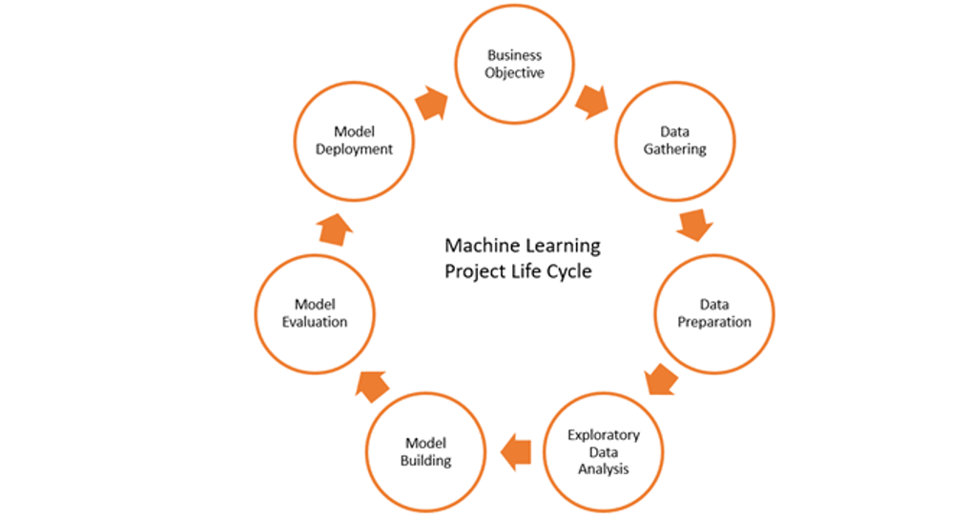
Life cycle of Machine Learning:

Slide 5
Agenda:
Prepare the Data and build a model to predict the churn of a customer.
Step - 1: Load the data
Step - 2: Document the below mentioned points properly:
- Identify the input and output/target variables.
- Identify the type of ML Task.
- Identify the Evaluation Metric.
- For regression task - Mean Absolute Error
- For classification task - Accuracy
Step - 3: Split the dataset into Training and Testing
Step - 4: Data preparation
Step - 5: Model Training Phase - Use all the algorithms mentioned below to train separate models:
- KNN
- Logistic Regression
- Support Vector Machines
- Decision Trees
- Random Forest
Step - 6: Predict and evaluate each model separately
Step - 7: Perform Hyperparameter tuning on the models to get the best model.

Slide 6
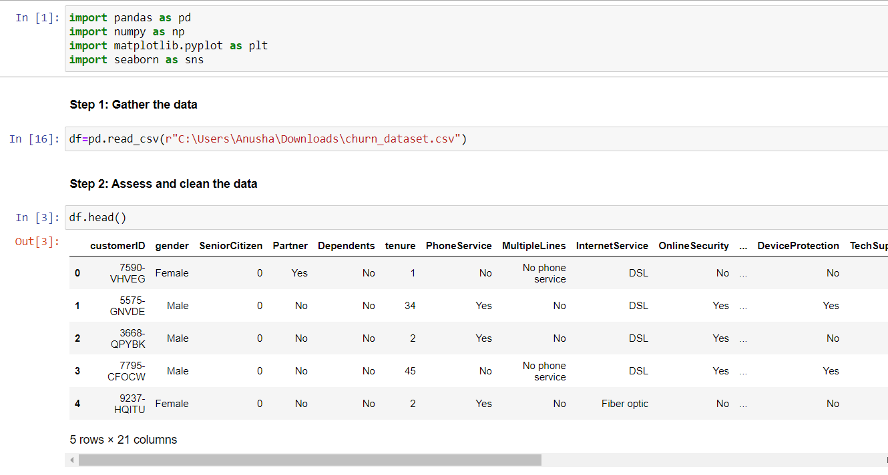
Load the data:

Slide 7
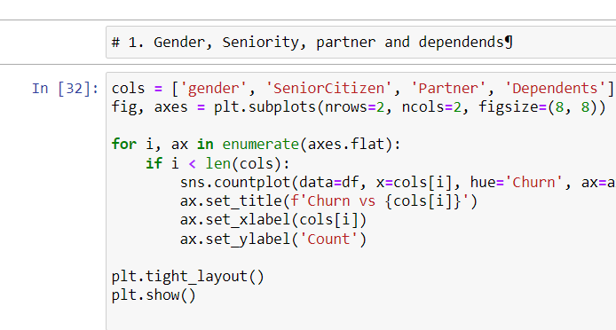
EXPLORATORY DATA ANALYSIS (EDA):
Univariate Analysis

Slide 8
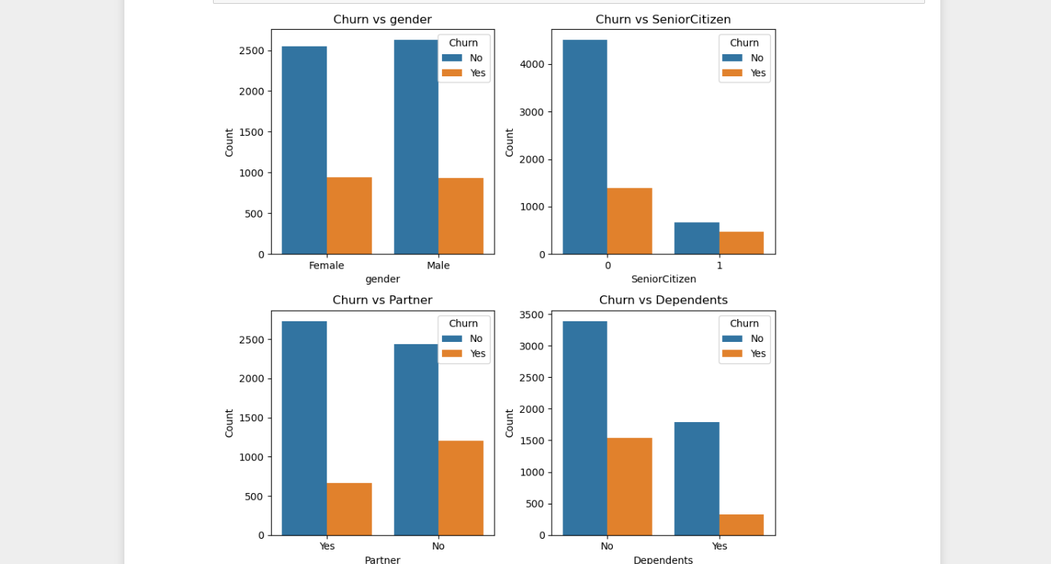

Slide 9
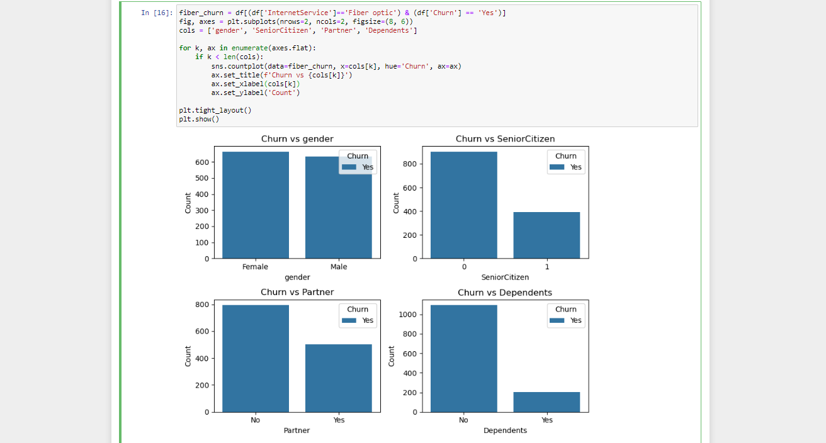
Bivariate Analysis:
Observation : We can conclude that customers who use phone service and churned are likely to be non-seniors, without partners and dependents.

Slide 10
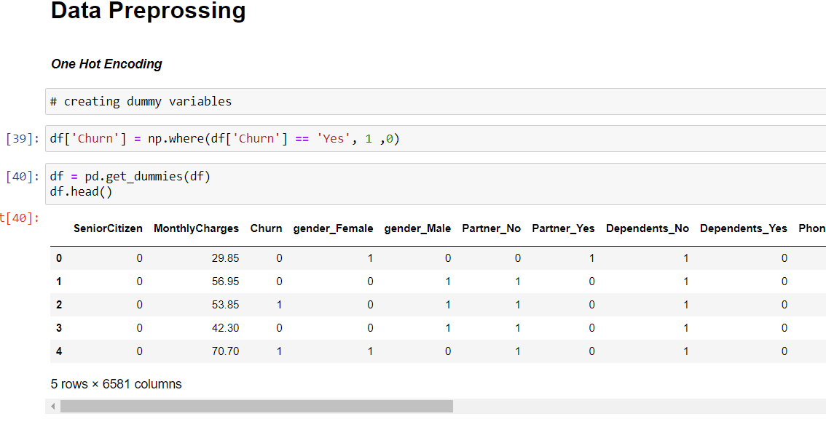
Data Preprossing:

Slide 11
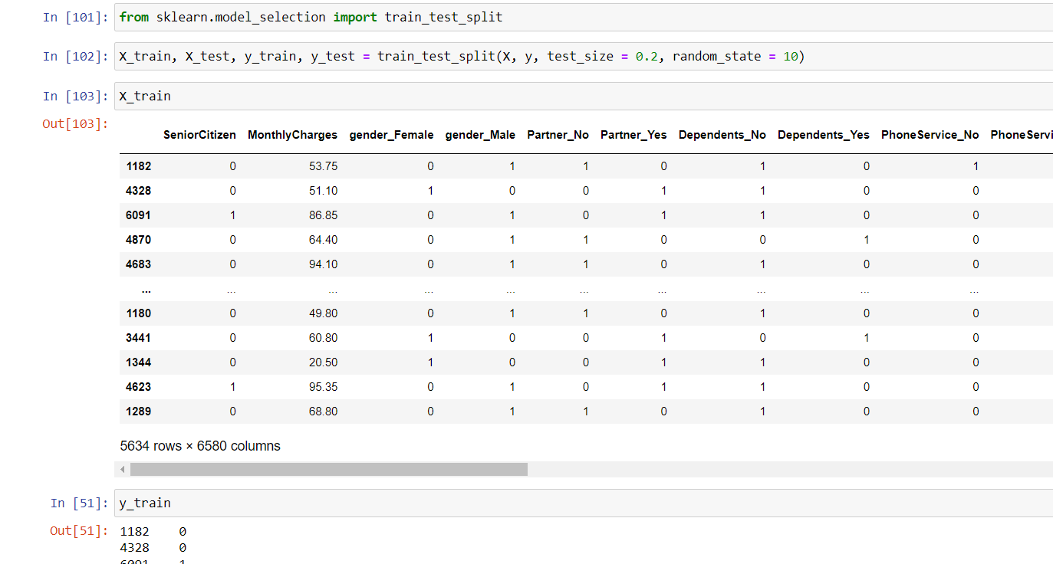
Split dataset into Train and Test :

Slide 12
Model Training Phase:
Use all the algorithms mentioned below to train separate models:
- KNN
- Logistic Regression
- Support Vector Machines
- Decision Trees
- Random Forest

Slide 13
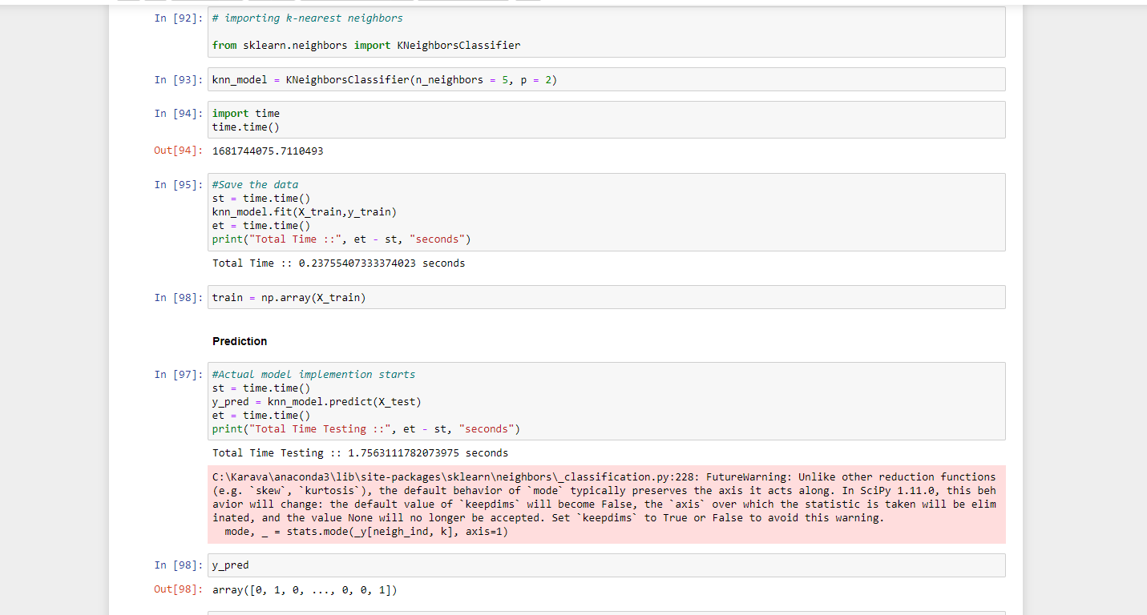
K-NEAREST NEIGHBORS (K-NN)

Slide 14
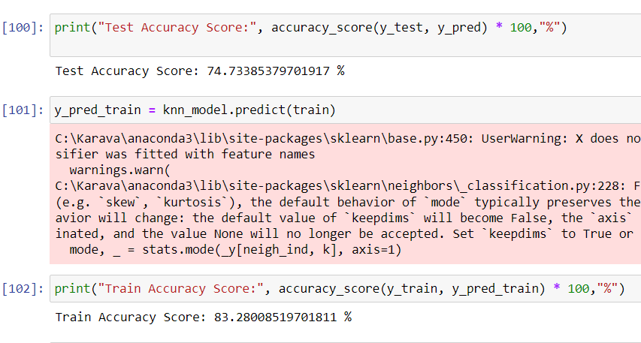
Accuracy Score

Slide 15
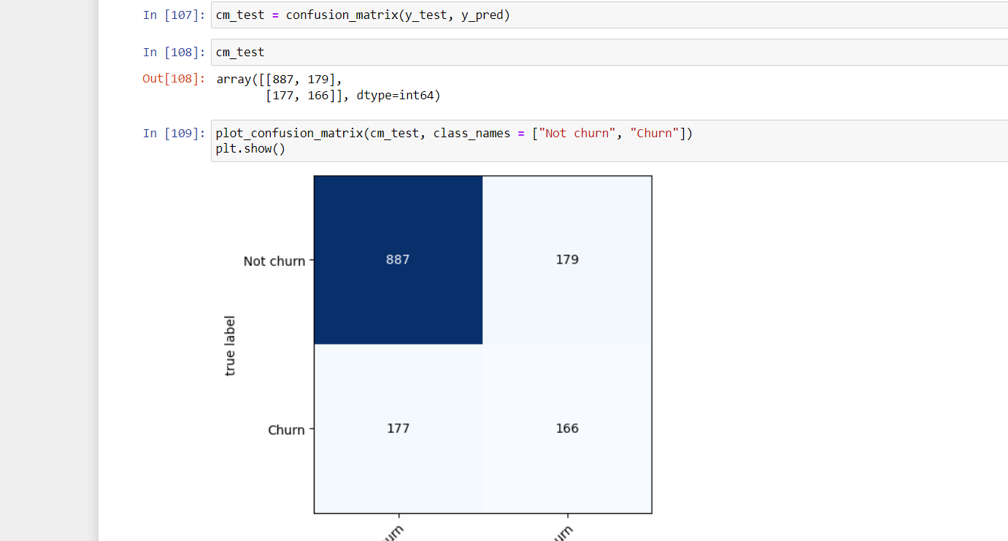
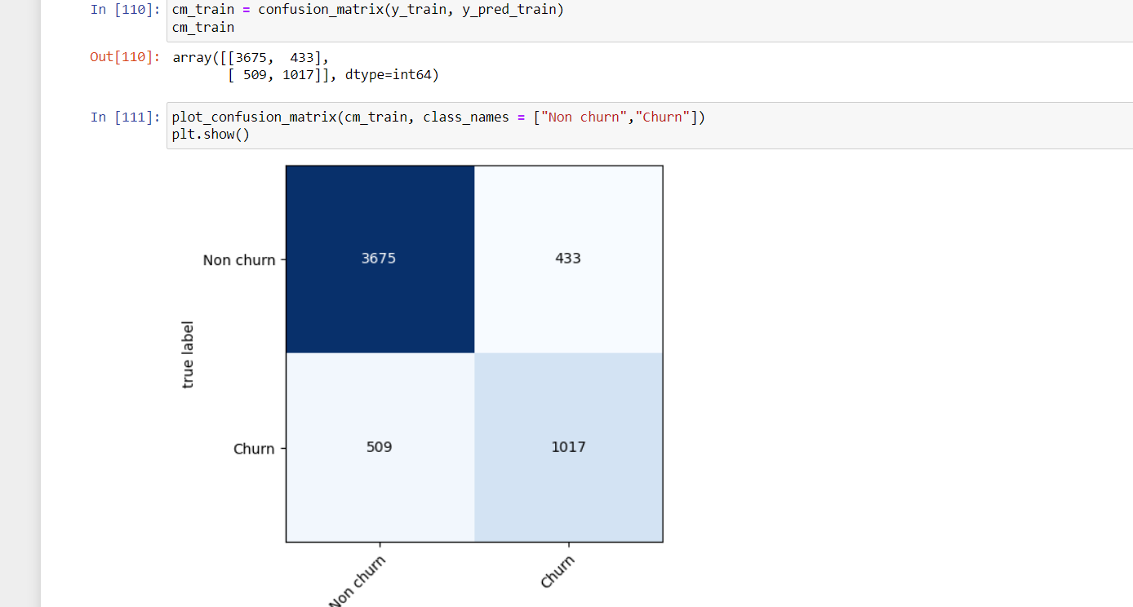
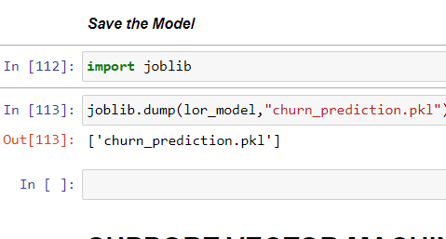
Actual : Prediction:

Slide 16
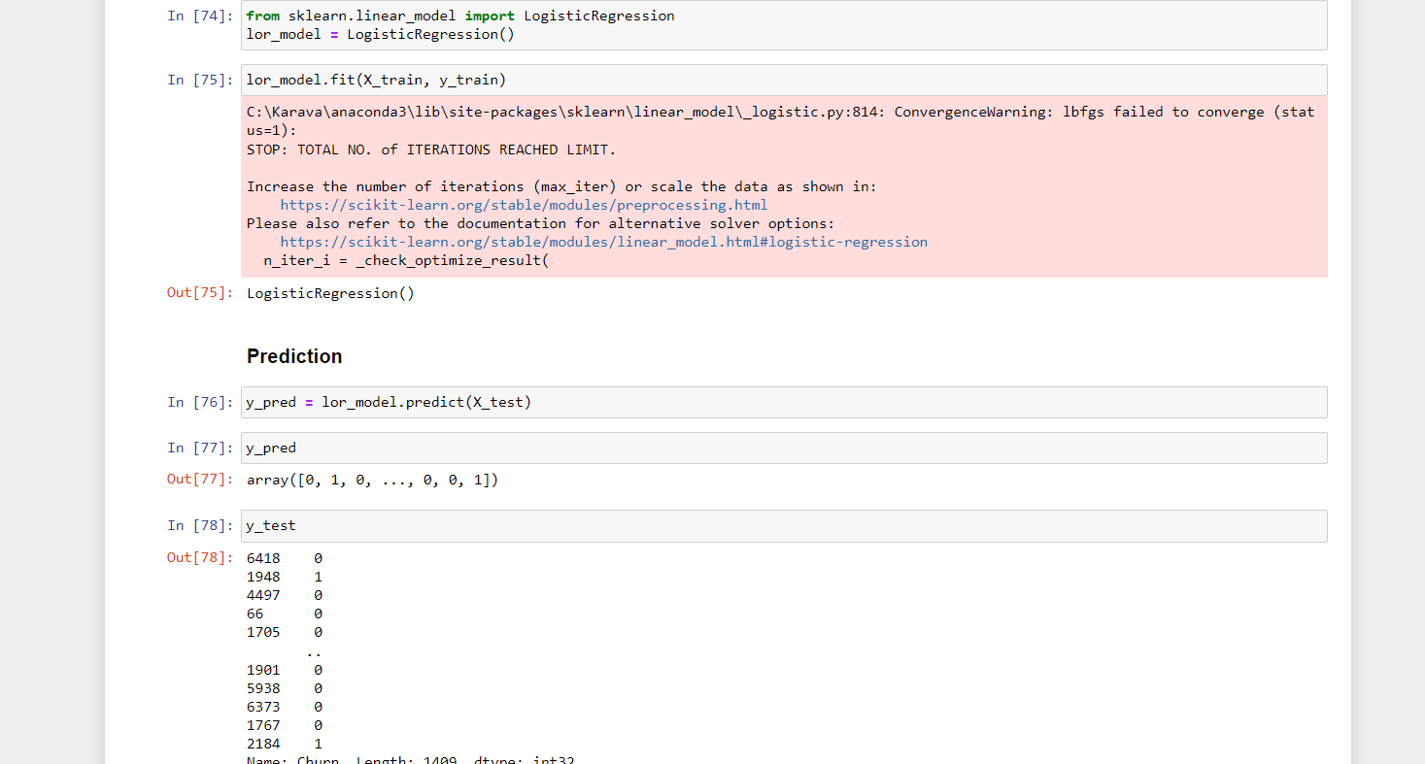
Logistic Regression

Slide 17
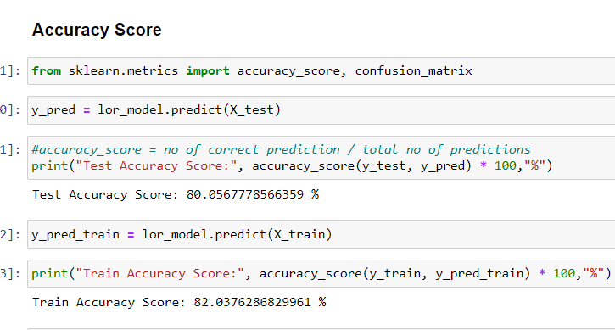
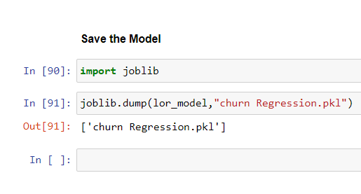

Slide 18
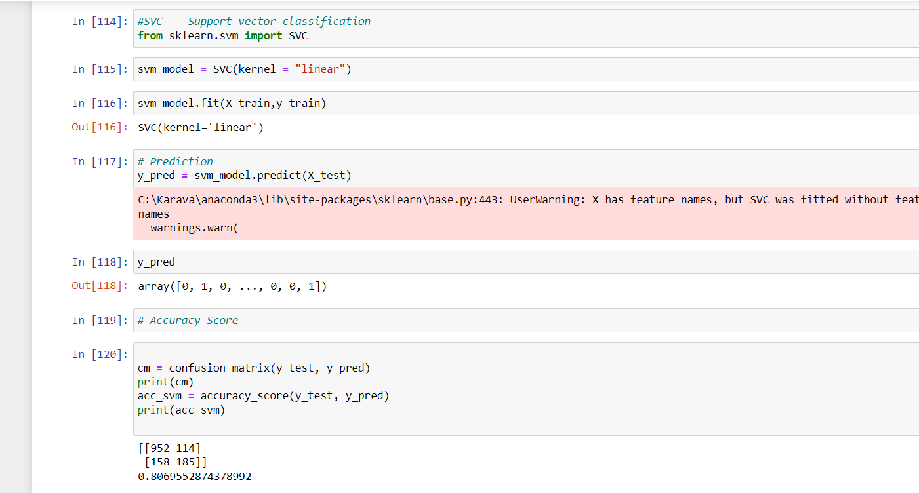
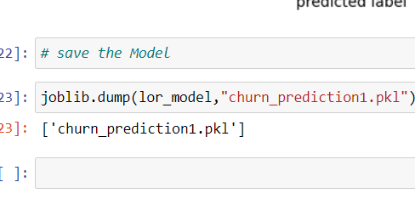
SUPPORT VECTOR MACHINES (SVM):

Slide 19
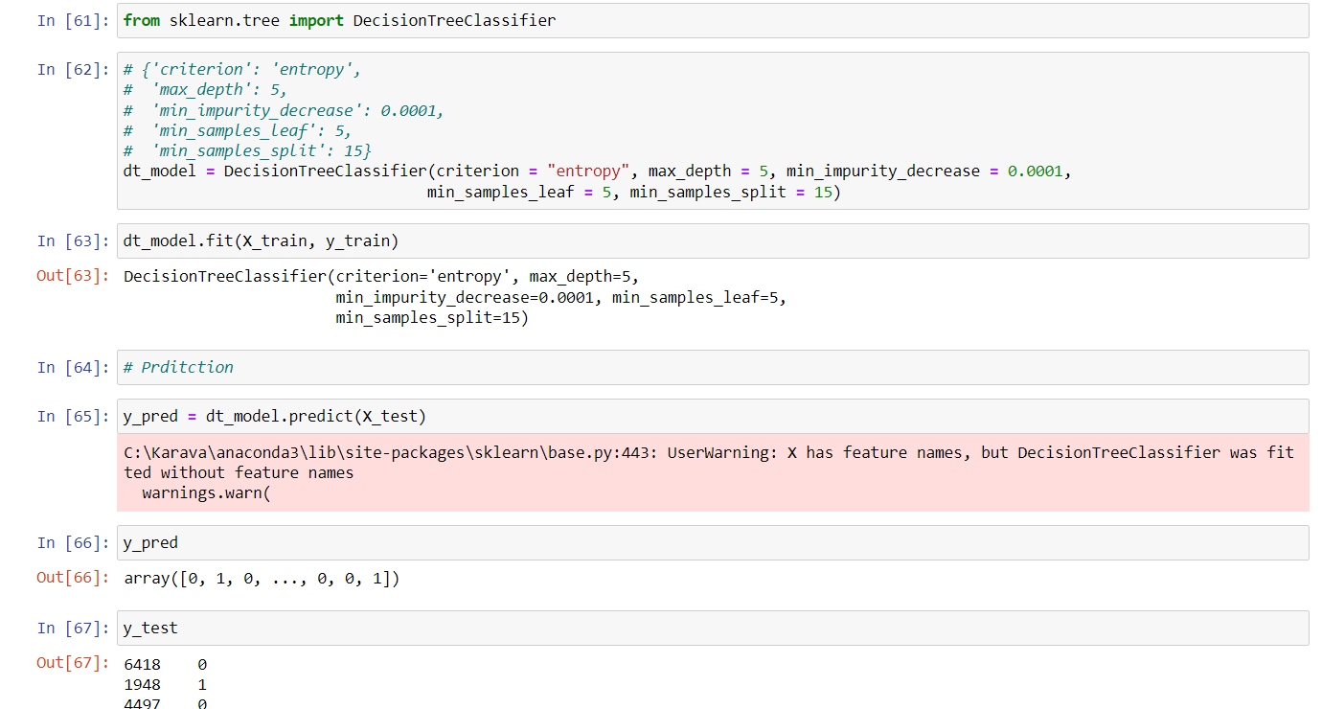
Decision Trees

Slide 20
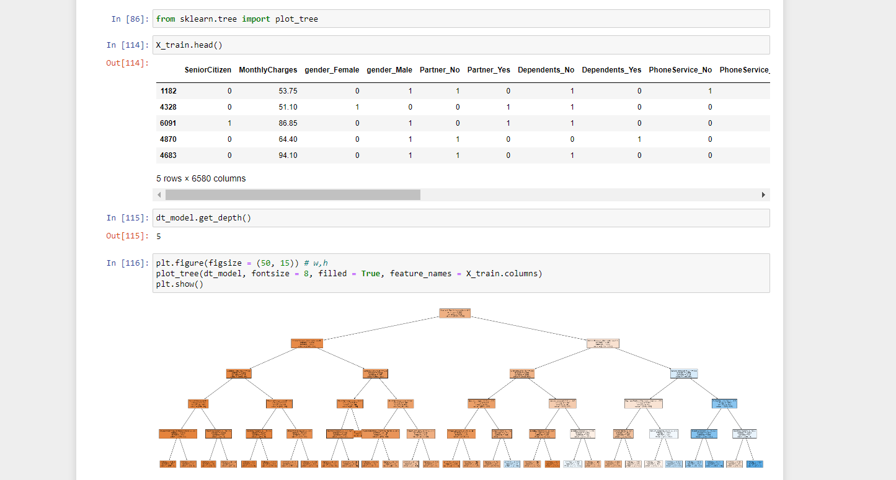

Slide 21
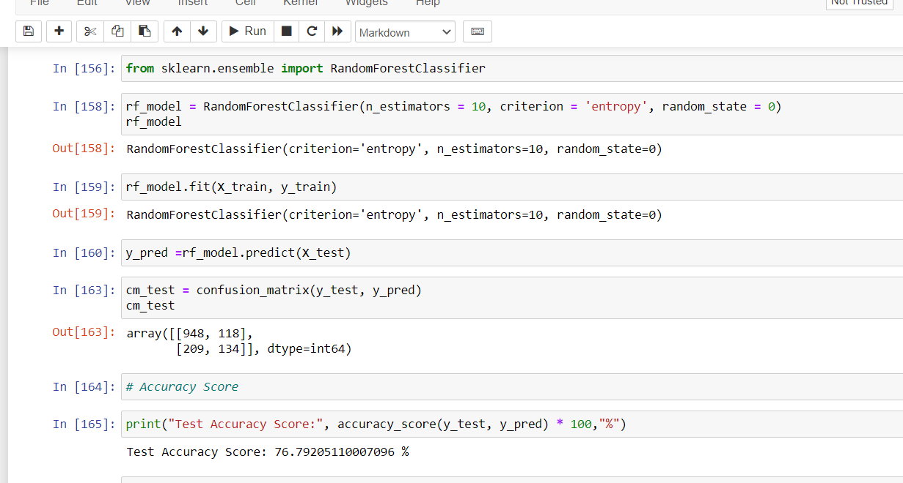
RANDOM FOREST

Slide 22
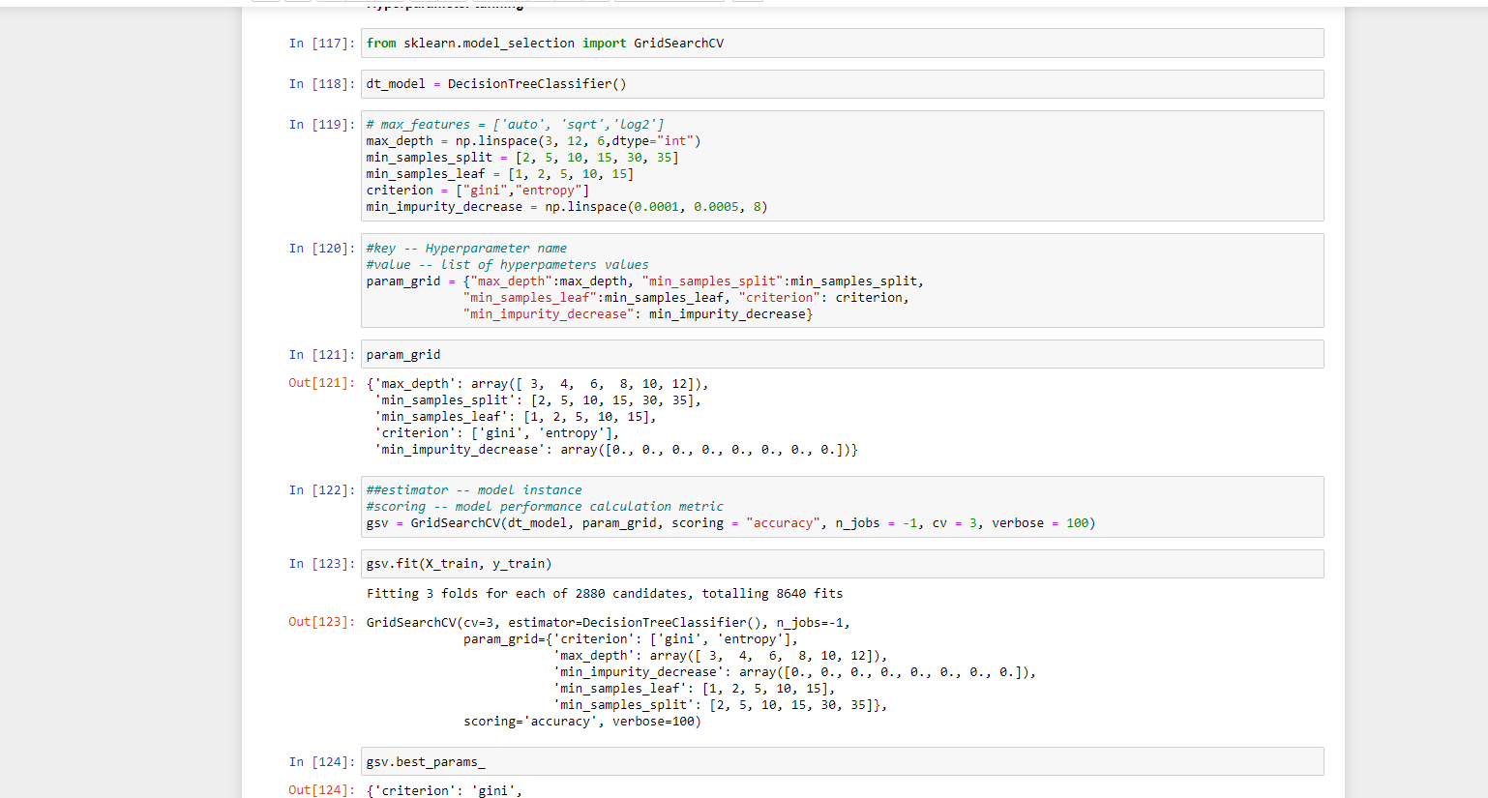
Hyperparameter Tuning:

Slide 23
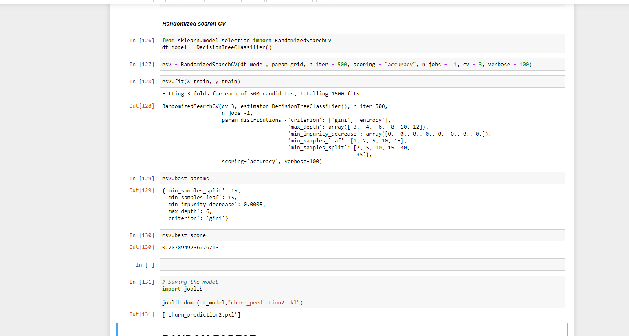

Slide 24
Conclusion:
1. We went through the various tasks involved in Churn prediction in this article. It is important to note that finding patterns in
Exploratory Data Analysis (EDA) is as important as the final prediction itself.
2. A Churn prediction task remains unfinished if the data patterns are not found in EDA.
3.This skill is not only limited to Churn prediction but will also help you in the solving of the usual data science problems.

Slide 25

THANK YOU

